Slide 1

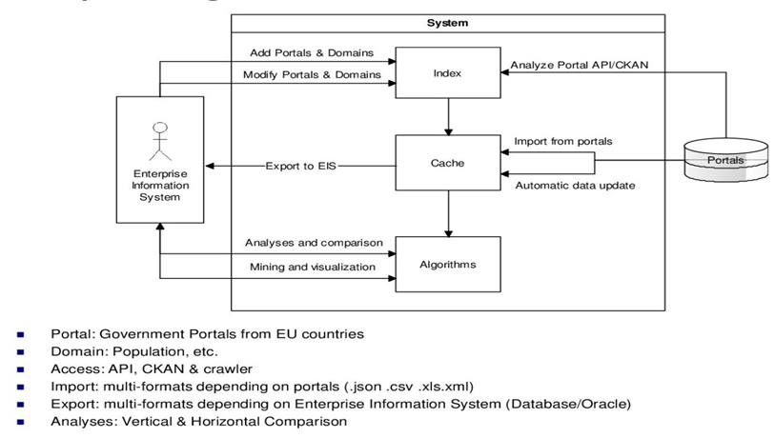
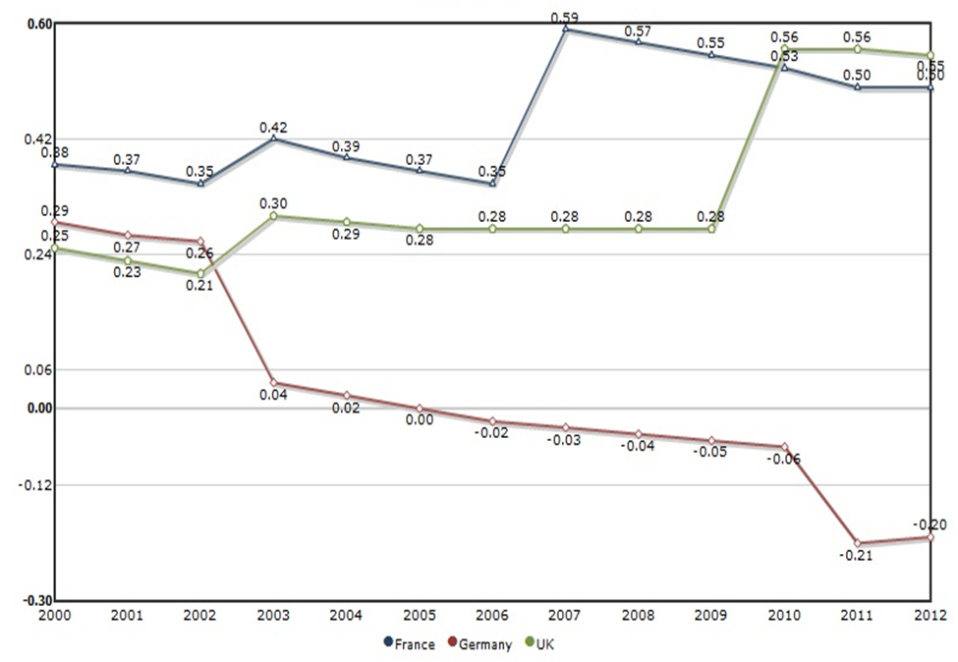



Exploiting Data
From Govt. Data Portals
Compare Portals, Download & Export Data to EIS, Analysis and Visualise Data
Muhammad Bajwa, Matriculation:2383436, Bajwa@informatik.uni-bonn.de, Group F
Judie Attard: attard@iai.uni-bonn.de, Prof. Dr.Sören Auer
Introduction The aim of this lab was to identify and compare a number of EU Government data portals. This included exporting data from these portals and importing it into an Enterprise System. A comparative analysis was then led on this data.
Issues in Data Portals to Access Data
No. Multi Lingual Data Portals No Single and Easy Data Access Point Non Availability of Open Machine Readable Data Set Formats Heterogeneity of Available API for Each Portal
System Architecture
Data Analysis and Visualization
This tool helps the user not only to analyze and visualize data per Portal but also compare data between the portals both in Graphical as well as in tabular forms. Population: The total number of persons inhabiting a country Population Density: # of people /kilometer Sqr. (Unit Area) Growth Rate: The average annual % change in Population Birth Rate: Birth/1000 Population Death Rate: Death/1000 Population
Growth Rate Comparison
Govt. Data Portals The Government is releasing public data to make its processes more transparent and to help people to understand how government works and how policies are made and to make easier for people to make decisions and suggestions about government policies based on detailed information and hear more about the Government's Transparency agenda from the Government. UK, Germany and France data portals was our pilot data portals from EU and Population as pilot data set domain.
 | UK | Germany | France
Website | www.data.gov.uk | www.govdata.de | www.data.gouv.fr
Data Access | Data Set , Map Search, Data Request | API, Combining Search Terms, Specific Fields Search, Fuzzy Search | Manual Download
API | CKAN | SCKAN, Liferay | EtaLab
Data Provision | CKAN | Manual: Web Forms, Automated: SKAN API, JSON Dump, CSW | EtaLab
Licensing | Open Gov. License | Open GL | Open GL
Data Usage | Free and Commercial under Open GL | Free and Non Commercial | Free and Non Commercial
Data Formats | XLS, CSV, HTML,PDF | XLS, CSV, HTML,PDF | XLS, CSV, HTML,PDF
Future Work and Recommendations
Multilingual Data download and Comparison Support Single and Easy Data Access Point Availability of Open Machine Readable Data set formats like RDF , JSON Etc. Homogeneous API for Data Access Multi Format ,Multi Lingual and Platform Independent Data Export to EIS and Data Visualization Tool
<Virtual Machine Description>
Hostname: Windows-ExpGovDataGroupF
Software Installed on EIS3
Visual Studio.net 2010: MSSQL 2008,ASP.Net, .Net Framework 4.5, IIS, EXDataExcel2EIS, Data Analysis and Visualization 1.0 Code Access: https://github.com/EIS-Bonn/MA-INF3232 Lab/tree/master/SomSem2014/Group%20F%20(GovData_Attard)
Local Access:
OS User: EIS-User
Password: GovData
Remote Access:
Partner ID: 902677001 Password: i34g3b
EIS
Enterprise
Information Systems

